Slide 1
BUILDING AND SUSTAINING MAINTAINABILITY
Unit-4

Slide 2
Building better systems
How to build maintainability into systems and what tools are available to help both the developer and the maintainer to provide better and more reliable systems.
Maintainability is needed in every software processes such as development, quality checking etc.

Slide 3
Definitions
High level language - a computer programming language that is similar to a natural language and that requires each statement to be translated or interpreted into machine language prior to execution
Impact analysis - the determination of the major effects of a proposed project or change.
Object oriented programming - computer programming in which code and data pertaining to a single entity (object) are encapsulated, and communicate with the rest of the system via messages
Quality assurance - the systematic monitoring and evaluation of aspects of a project, service or facility to ensure that necessary standards of excellence are being met.

Slide 4
Quality Assurance
Quality is widely defined as 'fitness for purpose' and this encompasses most of what many people mean when they talk about quality.
building maintainability into a system and, as such, maintainability will not be looked at as a quality factor by itself but rather as something which is affected by the other quality factors –
fitness for purpose
correctness
portability
testability
usability
reliability
efficiency
integrity
reusability
interoperability.

Slide 5
Another important issue which impacts upon the quality of a system is the appropriate use of standards
There are also quality standards specifically
adapted to the software process
UK's TICKIT-relates quality issues directly to software production
IEEE (STD) 1219-1993 -Standard for Software Maintenance

Slide 6
1.Fitness for Purpose
Fitness for purpose - does the product do the job it was intended to do -is an obvious criterion by which to measure quality. In order to see what it means in terms of the maintainability of a system it is necessary to look at how it is measured

Slide 7
2.Correctness
There is as yet no way of proving a system to be correct. Nonetheless ,there is much that can be done towards decreasing the level of errors in a system
Building correctness into a system has the obvious advantage that less time will be spent on corrective maintenance.
A maintenance-conscious life-cycle model will help maintain the correctness of a system.

Slide 8
3.Portability
Portability encompasses many things, for example moves between
hardware platforms, for example porting a system from a VAX to a PC;
operating systems, for example from Windows to LINUX to widen a market, from VAX/VMS to Windows when an organisation moves from a VAX base to a PC base;
programming languages, for example upgrading a system from DOS basedto Windows-based by rewriting in a different language or rewriting a system to adhere to a new in-house standard, for example Fortran 77 to ANSI C
countries, for example an organisation may wish to widen its market for a product from the UK to Europe. The product would need to be available in all European languages.

Slide 9
4.Testability
system that is easy to test is also easier to change effectively because it is easier to test the changes made.
It does not automatically follow that a system that is hard to test will be harder to change per se but if the system cannot be tested effectively, it is hard to engender confidence that modifications have been carried out successfully.

Slide 10
5.Usability
If a system for any reason is not used, it may as well not exist.
Maintenance is only an issue for a system that is used and that evolves with use.

Slide 11
6.Reliability
Varying degrees of importance can be attached to reliability, depending upon the application. Building in a high degree of reliability can be costly and is not always necessary. The reliability of an air traffic control system, for instance, must be greater than for a word processing package.
Reliability is closely allied to trust. If a customer has no trust in a system, he or she will not use it.

Slide 12
7.Efficiency
The efficiency of a system, how it makes use of a computer's resources ,is not always easy to quantify. A requirements specification will often specify speed and storage requirements and response times, but there is often an implicit assumption that a system will make 'the most efficient‘ use of the available resources

Slide 13
8.Integrity
The integrity of a system can be interpreted in 3 ways:
1. Is the system safe from unauthorised access?
2. Can system integrity be guaranteed from a configuration management point of view?
Has the system been built from a consistent and reproducible set of modules?

Slide 14
9.Reusability
Reusability is a factor that is absolutely central to the maintainability of a system

Slide 15
10.Interoperability
The ability of a system to interact with other systems is a very important factor.
People want to be able to move data between applications without loss. There was a time when it was all but impossible to move a document between word processors without, at the very least, losing all formatting information

Slide 16
Fourth-Generation Languages
In the early days of computing, programming was undertaken mainly by professional programmers
Conventional programming languages were an option, but required significant investment of time and effort to learn.
The tools to enable users to achieve these objectives were fourth-generation languages (4GLs).

Slide 17
classification of programming languages
The use of the term 'fourth-generation languages' stemmed from the classification of programming languages according to their generations.
The use of first-generation languages entails programming computers using binary notation. These languages require a good understanding of low-level details of the machine such as physical storage locations and registers.
Second-generation languages were an improvement of the first generationones. Instead of specifying the physical location in the computer, symbolic addresses are used to designate locations in memory .Second-generation languages are slightly less machine dependent
Third-generation languages, also known as high-level languages, are more independent of the machine than second-generation languages and as such their use does not require knowledge of the machine instruction set

Slide 18
disadvantages
high-level languages in comparison with their predecessors, they still present several difficulties which include
Writing and debugging programs is a significantly slow, difficult and expensive process
Many of them can only be used effectively by professional programmers. If there is a dearth of the relevant professionals, projects will be significantly slowed
The implementation of changes to complex software systems is slow ,difficult-and hence can greatly increase maintenance costs.
Several lines of code need to be written to solve a relatively small problem, thereby impeding programmer productivity

Slide 19
examples
Some 4GLs are described as non-procedural languages because they allow the user to specify 'what' the application is to do but not in detail 'how' this is to be achieved.
Examples of non-procedural languages include application generators, database query languages and form designers.
procedural languages include Pascal,Modula-2, Cobol, and C. Certain 4GLs, however, sometimes combine the characteristics of both non-procedural and procedural languages.

Slide 20
Properties of Fourth-Generation Languages
Martin and McClure [186, 188] in a survey carried out in the early 1980's provided an extensive list of these characteristics.
They are easy to use
They can be employed by non-professional programmers to obtain results.
They use a database management system directly
They require an order of magnitude fewer instructions than other conventional languages such as Cobol.
Where possible, they use non-procedural codeWhere possible, intelligent default assumptions about what the userwants are made.
They are designed for on-line operations
They encourage or enforce structured code

Slide 21
(4GL)Impact on Maintenance
By virtue of the above characteristics, the use of 4GLs to develop and maintain applications impacts on software maintenance in many ways
increased Productivity
Reduction in Cost
Ease of Understanding
Automatic Documentation
Reduction in Workload

Slide 22
Weaknesses of Fourth-Generation Languages
In spite of the above potential benefits to maintenance, these languages do have weaknesses which include the following.
Application-Specific
Proprietary
Overestimated simplicity of Use
Poor Design

Slide 23
Object-Oriented Paradigms
Early procedural programming is analogous to the 'waterfall' model. It developed in much the same way. It was appropriate to early software development contexts.
Originally, computers were used to solve well-defined, mathematically based problems. The idea of following a sequence of instructions was appropriate and relevant. Early programs written in machine code or assembler were the 'code-and-fix' and 'quick-fix' of programming languages. Simple sequences of instructions were fine for simple and clearly defined problems.
The object-oriented paradigm was developed to handle the design, development and maintenance of industrial-strength software

Slide 24
Algorithmic decomposition
was one of the most popular approaches used by software engineers and usually came under the guise of 'top-down structured design'. Here, the system is perceived as a process - or a collection of algorithms - and during decomposition,
The process is broken down into sub-processes each of which in turn is represented as procedures, functions or modules depending on the programming language.

Slide 25
Ex: the design (or algorithmic decomposition) of a spelling checker system yields the output given
This approach to software development and maintenance has a number of weaknesses.
Firstly the output from each phase of the life cycle is represented in a different form or language
Secondly, issues of abstraction and information hiding are not necessarily dealt with properly

Slide 26
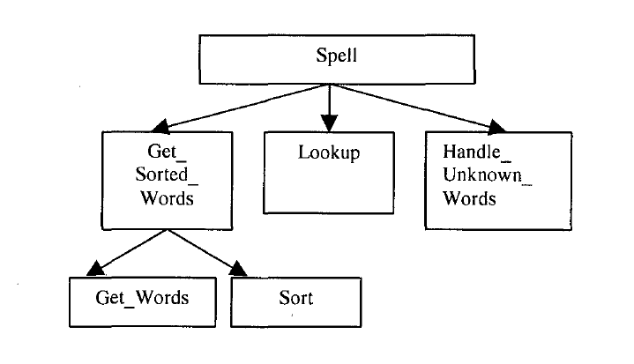
Algorithmic decomposition of a spell checker system

Slide 27
Decomposition to Aid Comprehension
Object-oriented decomposition is the approach in which the system is viewed as a collection of objects that interact to perform a higher-level function
The objects communicate with each other through message-passing; that is, sending instructions on the service that is required. Object-oriented decomposition involves abstracting these objects and operations from the problem domain
the object, Spelling Checker,first issues a message, Get Words, to another object, Document,requesting words. After receiving the words, Spelling Checker then instructs another object, Dictionary, to check the spelling of the words.This is achieved by passing the message, Lookup.

Slide 28
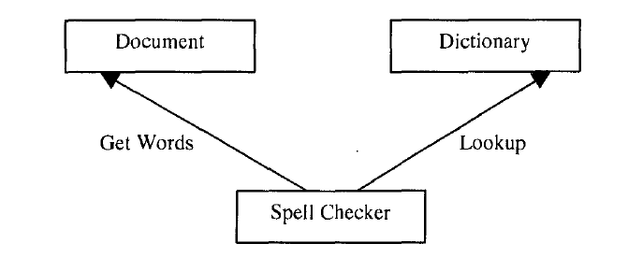
Object orientation of a spell checker system

Slide 29
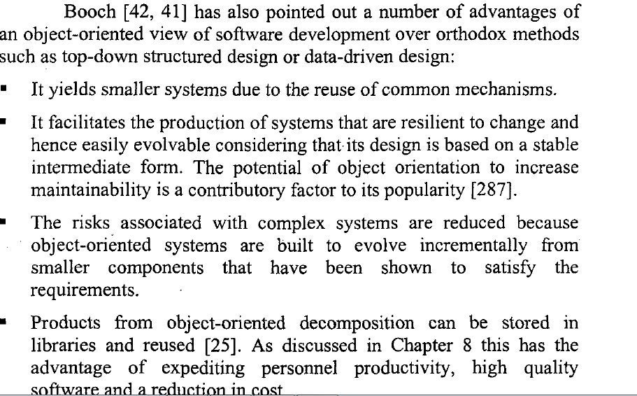
(OOP) Impact on Maintenance

Slide 30
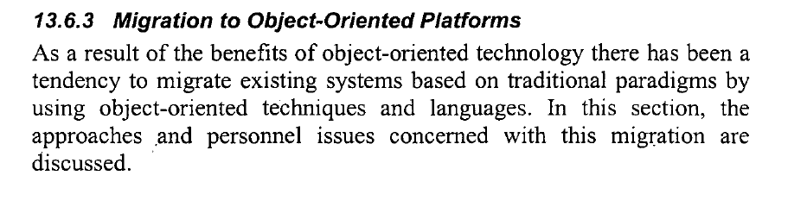

Slide 31
4 Approaches
Migration to object-oriented platforms can be approached in a number of ways.
The first is to rewrite the whole system. In other words, throwaway the current system and start from scratch, but develop the new system from an object-oriented perspective
The second approach to migration, especially appropriate in the early days of moves to object-oriented systems, was to use object oriented analysis as a 'springboard'; that is, perform object-oriented analysis of the existing system and implement it using a mainstream but non-object-oriented language such as Cobol or C and then migrate to a suitable object-oriented language at some later time
The third, and possibly the approach preferred by most organisations, is that which permits organisations to reap the benefits that object orientation offers as well as securing the investment that has been made in their existing systems

Slide 32
Retraining Personnel
An area that has been neglected is the retraining of personnel – analysts ,designers and programmers - already involved in main stream technologies or programming languages, such as structured programming and Cobol

Slide 33
Maintenance Tools
UNIT - IV

Slide 34
Definitions
Tool - implement or device used to carry out functions automatically or manually.
Software maintenance tool - an artifact used to carry out automatically a function relevant to software change.

Slide 35
Criteria for Selecting Tools
There are several vendors developing and marketing a wide variety of tools that claim to support software maintenance.
To acquiring a tool for software maintenance work, there are a number of factors that should be taken into consideration:

Slide 36
Capability
This is one of the most important criteria to consider when evaluating using a tool.
The tool must be capable of supporting the
task to be performed.
When a technique or method is to be supported by a tool, it is necessary to ensure first that it works without a tool. that is, by manually.
"if a technique doesn't work without automation, it won't work with automation“ - By Davis

Slide 37
Features
The features expected of any potential tool need to be considered.
Example: a useful word processor will need to provide not just an editor, but also other features such as a spelling checker, thesaurus, drawing and search facilities.
Similarly in maintenance, particular features may be required of a tool.
The importance of each of these features should be rated and the tool selected accordingly.

Slide 38
Cost and benefits
The cost of introducing a tool needs to be weighed against the benefits.
The benefits that the tool brings need to be
evaluated in terms of indicators such as product quality, productivity, responsiveness, cost reduction, and extent of overlap or dichotomy(contrast) between different groups with respect to their way of doing things

Slide 39
Platform
The platform refers to the specific hardware and software environments on which the tool runs.
Examples include: IBM mainframe and mini platforms such as MVS and AS/400 respectively; PC-based operating systems such as Macintosh OS,MS-DOS and Windows; and LINUX and UNIX variants.
The platform where the tool is to be mounted needs to be considered.
Notes:
MVS – Multiple Virtual Storage
AS – Application System

Slide 40
Programming language:
This refers to the language that will be used
to write the source code.
Examples include Java, Ada, C, C++,Cobol, Fortran, Modula-2, Lisp and Prolog. To be on the safe side, it is important to obtain a tool that supports a language that is already (or is likely to become) an industry standard.

Slide 41
Ease of use
The ease with which users can get to grips with the tool determines, to some extent, its acceptability.
Usually, a tool that has a similar 'feel' to the tools that users are already familiar with tends to be accepted more easily than one which is radically different.
For example, introducing a command-driven tool into a menu-driven environment will cause more problems for the users than a menu driven tool

Slide 42
Openness of architecture
The ability to integrate a tool with others from different vendors plays a major role in its extensibility and flexibility.
Another reason for selecting a tool with an open architecture is that in very complex maintenance problems a single product from one vendor may not be capable of performing all the required tasks.
Ex: CASE tools provide support for code analysis but lack the capability of extracting business rules from the code.

Slide 43
Stability of vendor
It is important to consider the reputation(status) of the vendor before acquiring a tool.
It is essential to look into the background of any company being considered as a supplier of a tool.
If the tool is one with an open architecture then this factor may not be so important.

Slide 44
Organizational culture
Organizations usually have a particular way
which they operate; a working culture and work patterns.
In order to increase the chances of the tool being accepted by the target users , it is essential to take such culture and work patterns into
consideration

Slide 45
Taxonomy of Tools
The categories of tasks for which tools will be discussed are:
Program understanding and reverse engineering
Testing
Configuration management
Documentation and measurement

Slide 46
Tools for Comprehension and Reverse Engineering
Program understanding and reverse engineering have been combined because they are strongly linked.
Program understanding involves having a general knowledge of what a program does and how it relates to its environment; identifying where in the system changes are to be effected; and knowing how the different components to be modified work.
Reverse engineering goes a step further by enabling analysis and different representations of the system to promote that understanding.
Tools for reverse engineering and related tasks such as redocumentation, design recovery, specification recovery and reengineering also achieve the same goal

Slide 47
Tools for Comprehension and Reverse Engineering
Examples of program understanding and reverse engineering tools include
Program slicer
Static analyzer
Dynamic analyzer
Cross- referencer

Slide 48
Program Slicer
The tool used to support slicing is known as a program slicer
The program slicer also displays data links and relareted characteristics to enable the programmer to track the effect of changes.

Slide 49
Static Analyzer
A static analyzer allows derivation of the information through careful and deep examination of the program text. Some authors also refer to this type of tool as a 'browser‘
Generally, a static analyzer:
Allows general viewing of the program text - serves as a browser;
Generates summaries of contents and usage of selected elements in the program text such as variables or objects.

Slide 50
Dynamic Analyzer
A tool that can be used to support this process is known as a dynamic analyzer.
Generally, the dynamic analyzer allows a maintainer to trace the execution path of
the system while it is running - it acts as a tracer.
This permits the maintainer to determine the paths that will be affected by a change and
those through which a change must be made

Slide 51
Data Flow Analyzer
A data flow analyzer is a static analysis tool that allows the maintainer to track all possible data flow and control flow paths in the program and also to backtrack.
This is particularly important when there is a need for impact analysis:
studying the effect of a change on other parts of the system. By tracking the flow of data and control, the maintainer can obtain information such as where a variable obtained its value and which parts of the program are affected by the modification of the variable.

Slide 52
Generally, a data flow analyzer also:
Allows analysis of program text to promote understanding of the underlying logic of the program;
Assists in showing the relationship between the different components of the system;
Provides pretty-printers that allow the user to select and display different views of the system.

Slide 53
Cross-Referencer
The cross-referencer is a tool that generates an index of the usage of a given program entity. For example, it can produce information on the declarations of a variable and all the sections in the program in which it
has been set and used.

Slide 54
Dependency Analyser
A dependency analyzer helps the maintainer to analyze and understand the interrelationships between entities in a program.
This tool is particularly useful in situations where logically related entities, such as variables, may be physically far apart in the program.

Slide 55
Generally, a dependency analyzer:
can provide capabilities that allow a maintainer to set up and query a database of the dependencies in a program.
Information on dependencies can also be used to determine the effect of a change and to identify redundant relationships between entities .
provides a graphical representation of the dependencies in a program where the node in the graph represents a program entity and an arc
represents the dependency between entities.

Slide 56
Transformation Tool
A transformation tool converts programs between different forms of representations, usually between text and graphics; for example, transforming code to visual form and vice versa
The tool usually comes with a browser and editor, which are used to edit the program in any of its representations.

Slide 57
Tools to Support Testing
1 Simulator
Using a test simulator, a controlled environment is set up for the testing to take place. The system to be tested is simulated in this environment and the appropriate set of tests carried out. The set-up and components of the environment will depend on the type of application being tested.

Slide 58
2.Test Case Generator
Sets of test data used to test the functionality of the system undergoing modification are produced.
The test data can be obtained from the system as well as data files.
The tool that assists in generating test data is called a test data generator

Slide 59
3.Test Paths Generator
Prior to undertaking integration and unit testing, it is important to know all the potential data flow and control flow paths that may have been affected by a change
This information enables the maintainer to carryout the appropriate set of tests to ensure that a change has achieved the desired effect.

Slide 60
Tools to Support Configuration Management
Effective configuration management is not possible without the aid of some kind of automated support tools in most maintenance environments
Keeping track of the objects produced during modification to a software system is not a trivial task. There may be thousands of files -source files, binary files - and an enormous amount of as sociated documentation.

Slide 61
Scm
Configuration management and version control support tools act as a repository for the objects that make up a software system. A specific configuration is created by taking objects - usually particular versions of source files - out of a central repository and putting them into a private work area.

Slide 62
1.Source Code Control System
Creation of a history file for a source code file on a UNIX platform would involve the following steps:
Renaming the original source code file in the current directory.
Creating the history file in the SCCS subdirectory.
Performing an 'sees get' on the renamed source code file to retrieve a read-only copy of the initial version.

Slide 63
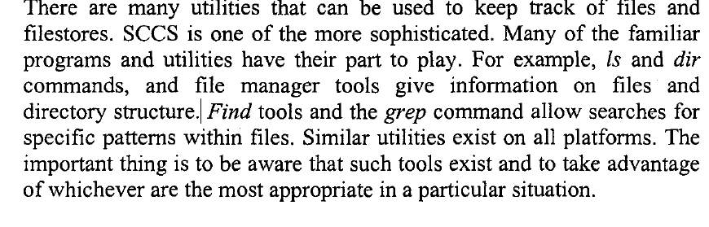
2.Other utilities

Slide 64
Other Tasks
Documentation
As stressed throughout this book, the importance of documentation for software maintenance cannot be over emphasised. Its importance is reflected in the observation that lack of documentation is considered to be one of the major problems that software maintainers face
Complexity Assessment
A complexity quantifier is a tool used to measure the complexity of a program. Such complexity measures are usually based on factors such as the underlying algorithm of a program or its structure. Tools that automatically generate, for example, McCabe's cyclomatic number can be used to pinpoint where the software is too complex to be reliable and to quantify the number of tests needed

Slide 65
The Past and Present
With time, software systems increasingly became an integral part of the fabric of many organisations, grew bigger and more complex, and their maintenance consumed a significant proportion - up to 70% - of the software life-cycle budget for these organisations
The two factors of rising maintenance costs and a reduction in resources for development of new systems marked a turning point in the treatment and perception of software maintenance issues

Slide 66
Research Areas
1.Classification
Classification is a classic aid to understanding, and classifying the elements of software maintenance helps towards a deeper understanding of the processes involved. Such classification is not as straightforward as it might appear. We have covered the topic to a degree within this text,but work on effective classification is on-going

Slide 67
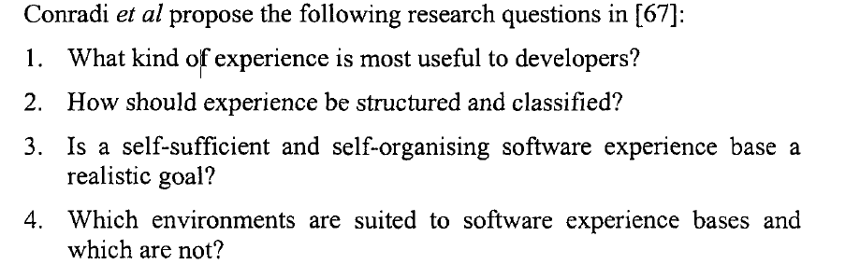
2.Software Experience Bases

Slide 68
3.Software Reuse
Software reuse is an area of great potential benefit to the software industry.
Many of the reasons it is not yet achieving its potential have not been fully explored - the management of the reuse process, there presentation of information appropriate to reuse, the legal considerations and so on.

Slide 69
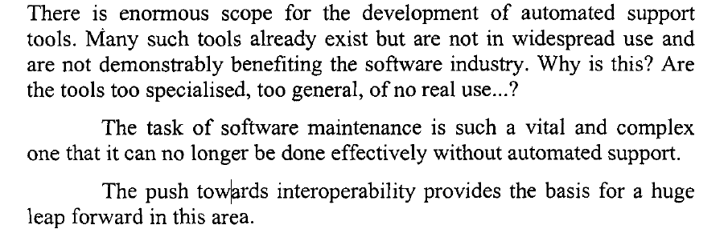
4.Support Tools

Slide 70
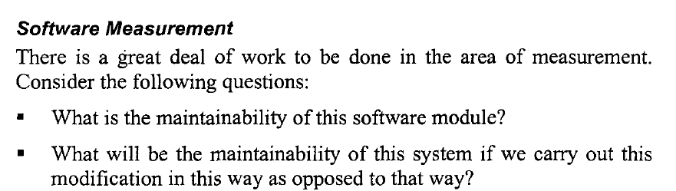
5.Software measurement

Slide 71
6.Program Comprehension
Teasley [265] provides thought-provoking insights into areas of programmer behaviour that are both very important and largely unexplored. She argues that any comprehension task is affected by three
major elements:
1. Who is doing the comprehending?
2. What are they comprehending?
3. Why do they want to comprehend?

